Slide 1
BI24 Review
Presentation for Offer Change Process (MP.AC.02) in ACS
Lean PLM EPIC 2.1
Presented by IZCD - 20 April 2022

Slide 2
Meeting rules
Meeting is recorded
Attendance
Participation
Side discussions
Meeting is being recorded to facilitate post BI Review processing with remote organisation. Please speak up if you’re against it !
At all participants, provide following information in Google Meet chat to track attendance
> Siglum > Role (and > “deputy of” if required).
Mute your microphone. To facilitate discussion, only identified key stakeholders are allowed to talk. List is here
Use other communication means than the main Google Meet for subsidiary discussions. ex:Google chat room
Constructive mindset
Understanding & Listening
Conclusion
Feedback Board
Aim is to align and set a baseline. There is room for evolution and improvements during next BI Review. Be positive and constructive !
Don’t interrupt people when they speak.
Refer to meeting moderator and wait for you turn to speak.
Always start by giving your name and role.
Keep 10 min at the end of the meeting to secure all topics have been properly addressed and way forward agreed (action plan, meeting scheduling,...)
The BI Review Feedback Jamboard is open. You can provide your overall BI Review feedback by Program or Function.

Slide 3
Manage Integrated Planning
AAT
MP.PM.02
Negotiate Contractual Agreement and Manage Order Book
Manage Fulfilment of Customer Orders
SE.CA.02.03
new
MP.PM.03
Layout
MSCN (creation)
MSCN
Cutomer Decision
To be updated with Develop Customized Module DP.
COM*
Fleet (mgt & milestones)
BFE list
Specific Request
RFC
SCN
(creation)
SCN Customer Decision
Manage and Develop Upgrade Solution
delta “as-contracted” - “as-specified”
Manage Product Offer Referential
SU.EC.01.01
Manage certification (to be updated)
Standard Specification
Catalogues
Upgrades RFC
Type Design Definition
Type Certificate
MP.AC.02.01
Offer Item
MP.AC.02.03
Simplified view - To be completed in next BI
MOD Approval
DE.AI.05
Manage A/C Configuration conformity
Resolve Fleet Issues
MP.AC.03.03
Manage Offer Changes & A/C Changes
SU.CP.03.01
MP.AC.02.05
RFW1000
Offer CRs
& A/C CRs
MP
MOD
Provide SB and Monitor VSB Approval or Acceptance
SU.EC.02
MP.AC.03.04
Manage Eqpt Change
SB
VSB
EqCR
EDES
Manage A/C Configuration Baseline
Product Configuration Target
Implementation Readiness Gates
Product Configuration Baseline
new
*: Commercial Allocation Planning

Slide 4


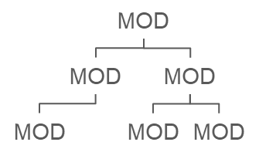

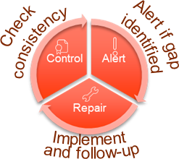
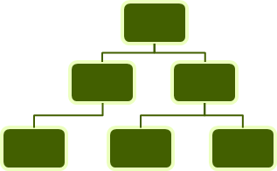
Lean PLM EPIC 2 overview - focus on Product Offer
As Proposed
As Selected
As Contracted
As Specified
As Designed
3D Library
SEP
eeDMU
GRM
EPIC2.1
Change Processes
Single integrated MOD/MP
Breakdown & MOD management
From Customer
EPIC2.3
Integrated solution
ACP
Shared workflows
Harmonized guidelines
Common and incremental studies
Integration of suppliers
Multifunctional Team
MBD preparation
E2E solution
From MBD proposal to Approval
From Airbus
OCP
MOD links, mixability and certification
Commonalities
ECP
Dynamic
Conformity Assurance
…
PFS
EDES
FFS
SR
Static
Automatic MBD build up
From Suppliers
RFW
CR
NOE
Cost
EPIC2.2
Definition
Product Offer Referential
EPIC1
A/C Configuration Integration
Std Product baseline
SR
EPIC2.4
Offer baseline in Offer Structure
Configurators Layout Selected options
RFC
SCN
MSCN
Fleet reference management
AAT Management
Policy
Rules
Hierarchical structure
Linked to DMU structure
ePublication
Pricing
Customer exposed Offer
As Selected
As Contracted
Fleet configuration management, Nomenclature (model, version/rank…)
Airbus know-how
Catalogue
Major value from EPIC2 ACS
Integrated ACP, ECP and OCP
Secure consistency between As Contracted and As Specified
Configured DMU and transition between SEP, eeDMU and GRM
On the shelves MBD and automatic MOD opening

Slide 5
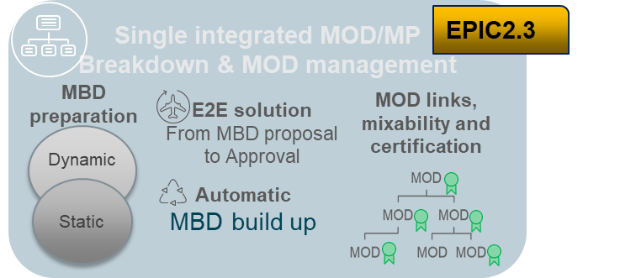
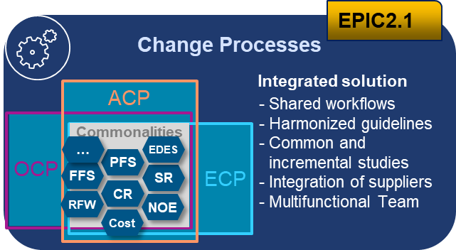

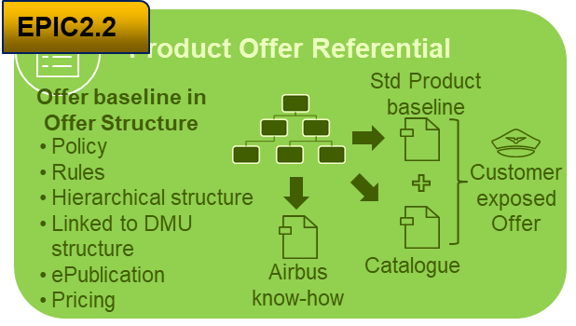
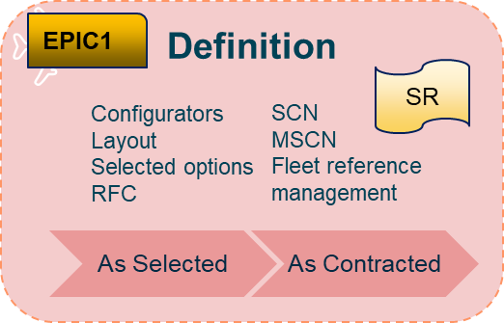

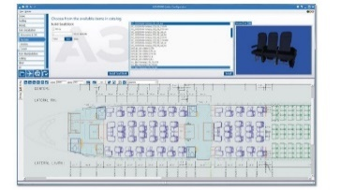
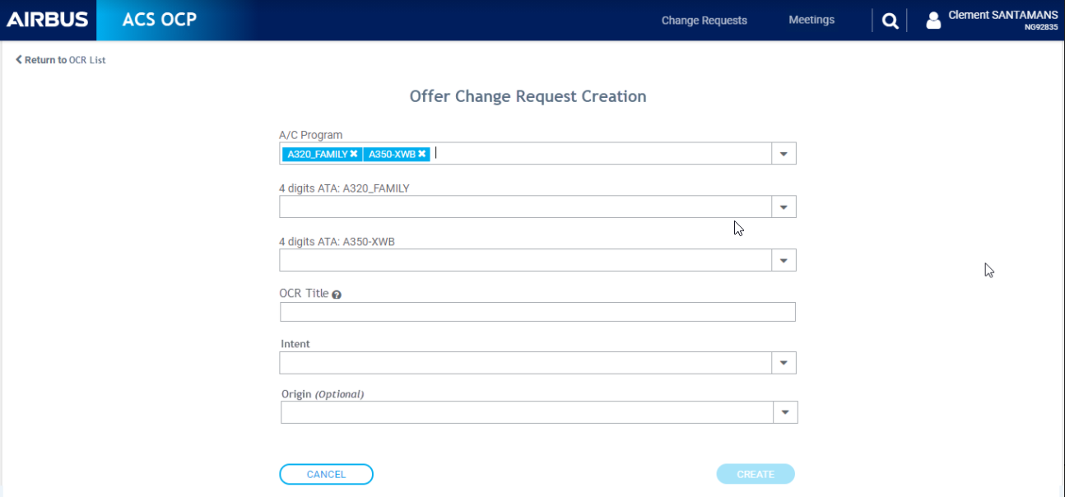


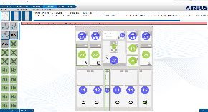

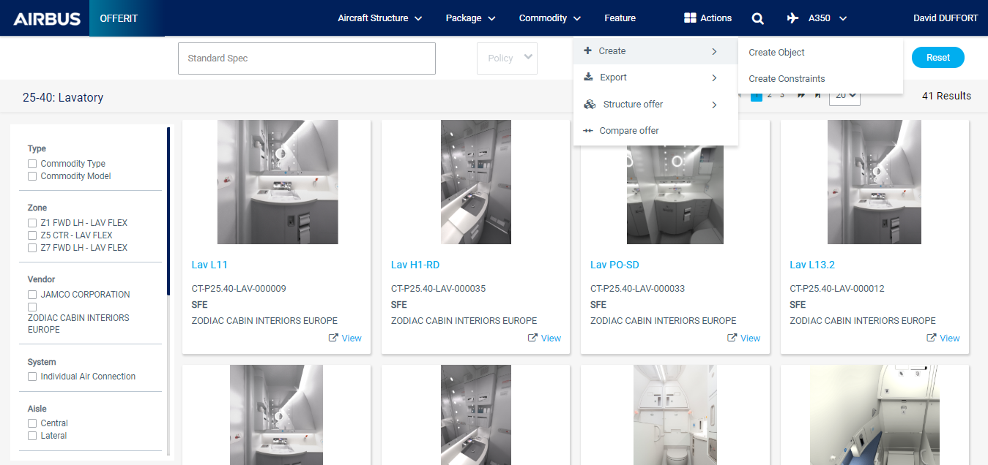
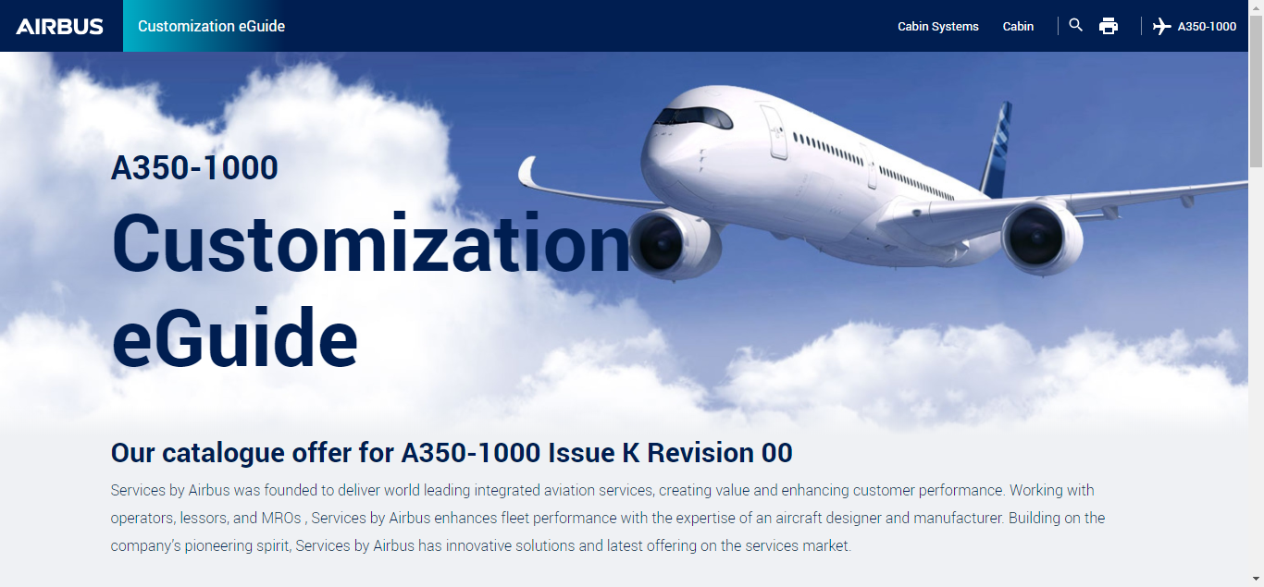

Overall Architecture (ICC-OCP, OfferIT)
ACS MBD Mngt
Mod Build Up management
CustomIT
OFFER CHANGE PROCESS / ACS
OfferIT to Configurators
Offerability decision (ATS, ATM, preATO, ATO); Selling Policy; Selection Conditions
Offerability decision dossier (Feasibility study, Workflow)
OfferIT feeds Configurators with
Offer items structuring (Positioning and Offer configuration)
Offer items definition (properties and constraints)
Offerability (Std Spec, Selling policies, Selection condition)
On demand
On demand
OfferIT for Airlines - eGuide generation for Product Offer introduction to Customers
(Presentation of CAT and Standard items with a modern Look&Feel)
OfferIT for suppliers
Generation of a Technical Document supporting transfer of information to suppliers

Slide 6
EPIC 2.1 overview: Change Processes
For Offer, A/C and Equipment Change Processes communities, who has to manage Offer development, standard and customization design changes, the Integrated Offer, Equipment and A/C Change Processes is a Single digital platform that harmonizes Method, Process and Tools providing seamless data continuity and traceability of all change processes.
ACC
Aircraft Change Process
ICC
ACS
PFS / FFS/ RFF
CR Study
No Digital Continuity
Trackdev
Aircraft Change Process
Equipment Change Process
Supplier Study
Equipment Change Process
No Digital Continuity
Offer Change Process
Offer Change Process
A350 POT
One Study Management
Aligned Workflow Management
One Data Management
Offer Study
RFW
ICC
Offerit
SysConf
Seamless Digital Continuity

Slide 7
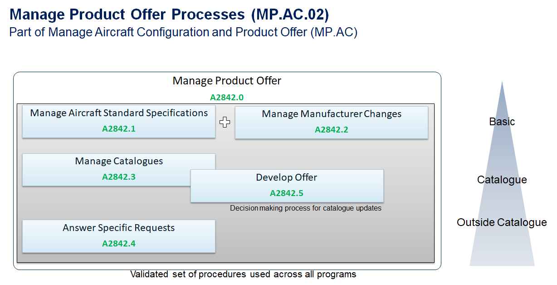
Overview of current Product Offer Processes
Partially ‘obsolete’ processes, under reengineering as part of Lean PLM
DOP MEMO
ME2005469
EPIC2.1 Identified Use cases

Slide 8
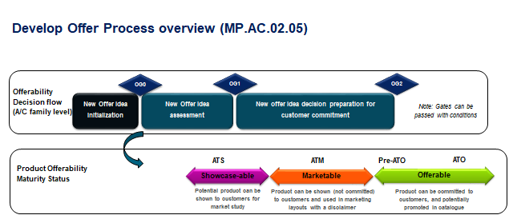
Process OUPUTS:
OGx passed, ATS/ATM/pre-ATO/ATO decisions
Study launch (and type)
Selling Policy decision (and decision dossier)
Selection conditions (Risk) decision
Offer item/EPAC/TDU available to open RFC
other processes
ACP
MP.AC.03
ECP
MP.AC.0x
FCO/Contract/Def
MP.PM.03
Engineering
DE.PA, DE.SO
Procurement
Marketing
Note: Processes I/Fs to be clarified

Slide 9
TO BE PROCESS Use case #10
Development of a new linefit Offer item with a Launch Customer
#10
MVP
Use case #10
NOE for BFE (from Procurement)...
Eq CR
Offer Boards/decisions ToR
Projects..
RFW 8000, GES
EqCR from Supplier
OCP MP.AC.02
Offer Items
Offer Items
Offer Items
ATS
ATM
Pre ATO
ATO
Draft
Ready for OG0
OG0 passed
Ready for OG1
Ready for OG2
Offer CR
OG1 passed
OG2
passed
Create Offer Change Request
Initiate Decision Dossier
Manage OG0 Board
OG0
Complete Decision Dossier
Manage OG1 Board
OG1
Update Decision Dossier
Manage OG2 Board
OG2
Product Offer Manager
OPR/AligntMeet/CPB
OPR/AligntMeet/CPB
OPR/AligntMeet/CPB
ACP
DRAFT
single-pgm
A/C CR 1
...
A/C CR N
Create A/C Change Request
A/C Change Process
KoB
MB
DB

Slide 10
OCP MVP Flow Process (MP.AC.02.05) for catalog type OCR
Manage OG0 Board
Manage OG1 Board
Update Offer Dossier
Manage OG2 Board
Product Offer Manager
Create Offer Change Request
Initiate Offer Dossier
Complete Offer Dossier
OCR status
Draft
Ready for OG0
OG0 passed
Ready for OG1
OG1 passed
Ready for OG2
OG2
passed
Product Offerability Maturity Status
ATS
ATM
Pre ATO
ATO

Slide 11
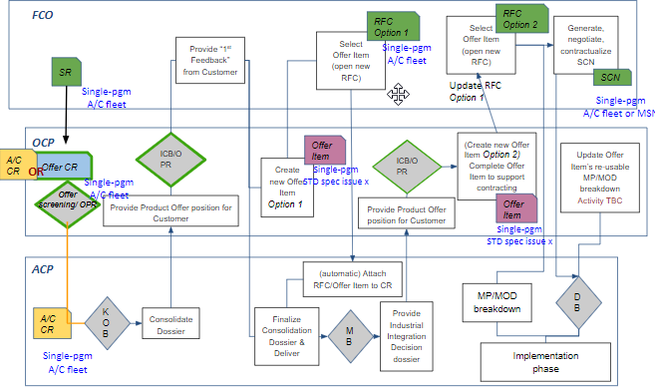
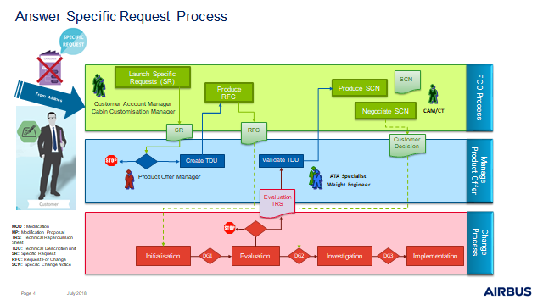
Answer Specific Request Process (MP.AC.02.04)
Use case #01
New process definition in progress
(As Is)
DRAFT

Slide 12
Expected benefits for OCP
OCP-ACS MVP
OCP-ACS IVP
OCP-ACS FVP
.
Develop Offer Process in ACS
Single source of truth for offerability Maturity statuses (ATS, ATM, pre-ATO, ATO), passed gates and reasons for decision & conditions.
Eased alignment/decision meeting management.
Integration of the DOP in ACS with ECP and ACP
Possibility to trigger the change automatically in other change processes
Digitized / Harmonized Feasibility Study
Link to engineering processes for monitoring of eqp change TBC
Answer Specific Request Process in ACS
Feasibility Studies Management linked to other CM object
Offerability and Risk life cycle management in ACS ensuring fitting the market (e.g. Best Seller)
Standard MOD impact management on Offer in ACS (improvement of the workflow for the std spec and custo)

Slide 13
OCP-ACS (part of EPIC2.1) roadmap
21
22
23
24
25
PI21
IVP
MVP
MVS
FVP
Q1
Q2
Q3
Q4
Q1
Q2
Q3
Q4
Q1
Q2
Q3
Q4
Q1
Q2
Q3
Q4
Q1
Q2
Q3
Q4
Offer Change Process - Integration
Use cases: Integration of change processes: ACP, ECP, OCP
Create Offer Change for new item
A350 POT data migration
Follow-up of offer item in Develop Offer Change Process and partial ASR study for new item
→ 2.2
EPIC 2.2
Automatically push Develop Offer decisions status in Offer Referential
Engineering Focal point for studies: Florian Beckard
Study: Align Offer Studies with other change processes, define I/Fs
Perform (workflow) Develop Offer Decision Dossier for OG0/ATS, OG1/ATM, pre-ATO, OG2/ATO
EPIC 2.1
Answer Specific Request improvement - study management, SR link with FCO process (UC#01)
EPIC 2.x
EPIC 2.1
Best seller study and decision management TBC
EPIC1
Offer - Offerability life cycle management - Selling Policy change - Monitor Offer
Offer - Risk Management - Selection Conditions Management - (after initialization through DOP)

Slide 14
OCP MVP One Pager
ICC-OCP tool
1st brick - MVP
Main functionalities:
Create/Modify an Offer Change Request (with DOP intent, answer SR intent).
Follow the Offer CR and record associated data (decisions…):
through Develop Offer Process: OGx /ATx (catalogue intent)
or to ease decisions and traceability of Answer Specific Process for ‘some important’ HoV new items (full new ASR process will be supported by IVP)
Attach to an OCR, the elements used for decision (studies, business case, mails, …).
Visualize all decisions / data linked to an Offer CR.
Meeting management:
Create/organize a meeting: different types (CPB, OPR, alignment meeting)
Create an automatized agenda (based on the Offer CR maturity)
log the decisions
create an automatized MoM
Manage different access rights (reader, writer, admin…).
Provide filtering/search functions to easily retrieve data.
ICC-OCP MVP
Single source of truth for offerability Maturity statuses (ATS, ATM, pre-ATO, ATO), passed gates (OGx) and reasons for decision & conditions /selling policies.
Meeting management for Offer Boards (agenda, MoM)
Develop Offer Process in ACS
Single source of truth for offerability Maturity statuses (ATS, ATM, pre-ATO, ATO), Best Seller status, passed gates and reasons for decision & conditions.
Eased alignment/decision meeting management.
In line with A350/A330 needs for Product Offer Tool replacement (obso 2022)
In line with A320 Cabin expressed needs

Slide 15
EPIC2.1 ACS - Offer Change Process
MIV
MIP
EIS
Major milestones | 2022 |  |  |  |  |  |  |  |  |  |  |  | 2023
Blue/Orange plan | Jan | Feb | Mar | Apr | May | Jun | Jul | Aug | Sep | Oct | Nov | Dec | Jan | Feb
2.1 OCP
Epic 2.1 - Offer Domain
MVP OCP
MVP OCP
MVS OCP
MVS Change Processes integration
P
R
S
MVS OCP >
OCR creation
My OCR List / My Team OCR List
OCR dossier: general, study, applicability, link to offer referential items, customer (marketing)
Offer Meeting management > creation (CPB, OPR, Alignment meeting)
My Meeting list
Meeting agenda creation
Agenda export
Info topic management
Meeting participants management.
Meeting run
MoM management and export
Out of meeting decisions management
OCR copy creation
Notifications management
Global Search
Versioning
UAC external capacity (visibility, editing) (subcontractor right)
Filters (MyOCR list, My Meeting List, Notifications…)
ICC-OCP Data exposure (Skywise, eBAM...)
OCP MVP in ACS - Assistance site & awareness
Business Operational Support

Slide 16
Way of working in CPAO ART: BI & PI
2021
Q1 |  |  | Q2 |  |  | Q3 |  |  | Q4
J | F | M | A | M M | J | J | A | S | O O | N | D
BI
PI
EIS 1 ready (MVS)
EIS 1
MIP
BI/PI18
BI/PI19
BI/PI20
BI/PI21
BI/PI22
STUDY: Processes streamline ACP, OCP and ECP Harmonization of studies (OCP, ACP, ECP) and process I/F definition
OCP MVP in ACS FEATURE: User Management
OCP MVP in ACS FEATURE: OCR creation
OCP MVP in ACS FEATURE: OCR List - Welcome
OCP MVP in ACS OCR List - manage columns...
OCP MVP in ACS FEATURE: OCR dossier
OCP MVP in ACS FEATURE: Create meeting
OCP MVP in ACS FEATURE: Meeting management (agenda & MoM)
BI Review
BI Review
BI Review
BI Review
BI Review
22SP
60 SP (2 features descoped descoped during the PI)
Move Into Production (MIP) : Tool deployment into the production environment

Slide 17
Way of working in CPAO ART: BI & PI
2022
Q1 |  |  | Q2 |  |  | Q3 |  |  | Q4
J | F | M | A | M M | J | J | A | S | O O | N | D
RELEASE
RED LOTUS
RELEASE
SANGRIA
BI
PI
EIS 1 ready (MVS)
EIS 1
MIP
BI/PI23
BI/PI24
BI/PI25
BI/PI26
BI/PI27
BI Review
BI Review
BI Review
BI Review
BI Review
OCR dossier: CUSTOMERS
Create new meeting
Display My Meeting list
Meeting agenda (part 1): header
create new OCR (initiate from)
Meeting agenda (part 2)
Run meeting
Out of meeting decisions
Manage info topic (agenda & MoM)
Meeting: manage participants...
Export MoM (E223514) Export Agenda
Notifications and Actions - 2.5
Global Search
Versioning
UAC external capacity (visibility, editing) (subcontractor right)
Filters (MyOCR list, My Meeting List, Notifications…)
ICC-OCP Data exposure (Skywise, eBAM...)- 2.5 Bernd
OCP MVP in ACS - Help & trainings, deployment plan
Business Acceptance Tests
A350 POT data migration
PI23: approx. 16 SP + meeting enablers
(approx. 3 features taken over 6)
Business Acceptance Tests
decsoped during PI24
draft feature 5 Apr
draft feature 12 Apr
Enabler
DRAFT

Slide 18
After ICC-MVP: improvement
how to handle pre SR studies (through info topics?)?
Why don’t we want to create a SR (e.g. ‘Emirates is not happy with …)? Because the request is not mature enough, evolves… this considered as a Customer Request (less mature that a SR)
Proposal: SR draft to trigger quick assessment
info topic improvement request TBD by Business (Malika, Patrick, Loic), will be presented to Armelle/Olivier
Offer referential reference to be linked to new EPAC/TDU module or EPAC/TDU in Offer it or form Sysconf BO?
-> to be checked with Clement
MVP: add description & attachment in GENERAL in OCR Offer Dossier -> planned in CONTEXT RTD feature

Slide 19
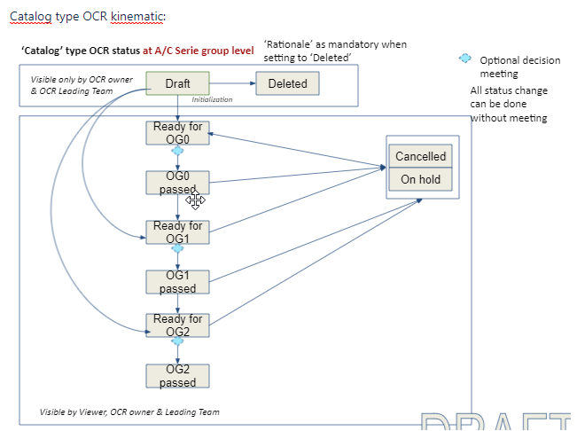
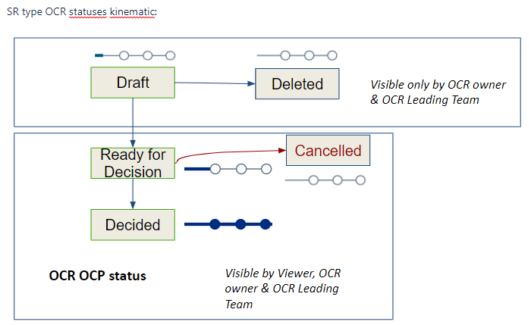
Offer Change Request workflow, for Catalog & SR type

Slide 20
PI21, PI22, PI23 & PI24
ICC-OCP MVP performed developments
presentation

Slide 21
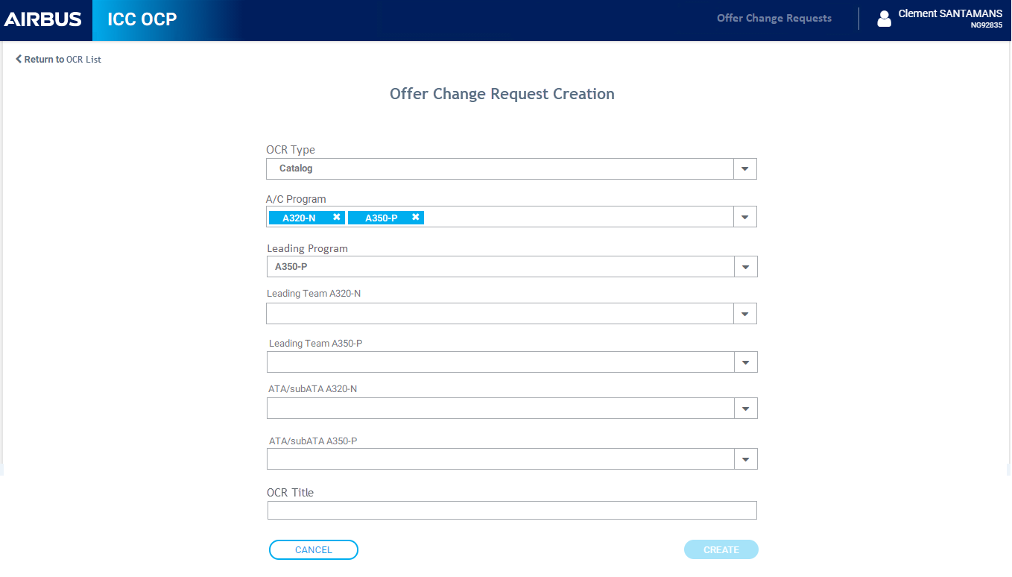
OCR creation : Catalog type
PI21

Slide 22
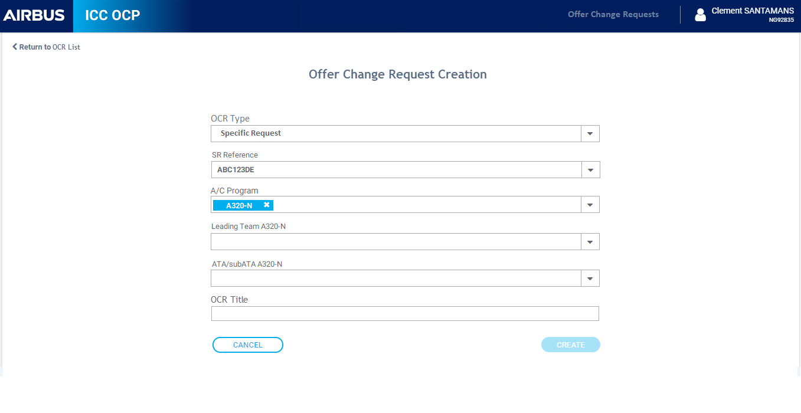
OCR : SR type
PI21

Slide 23
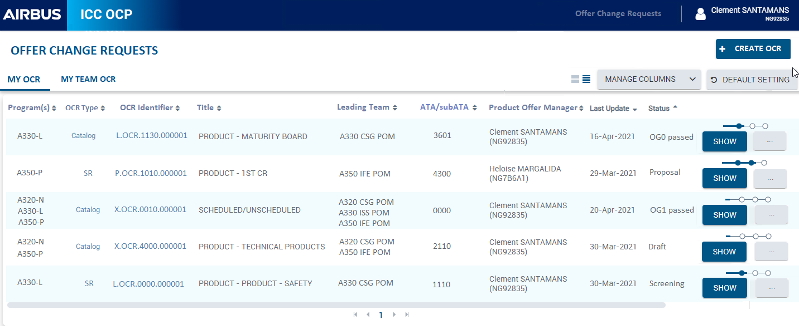
My OCR list
PI21
PI22

Slide 24
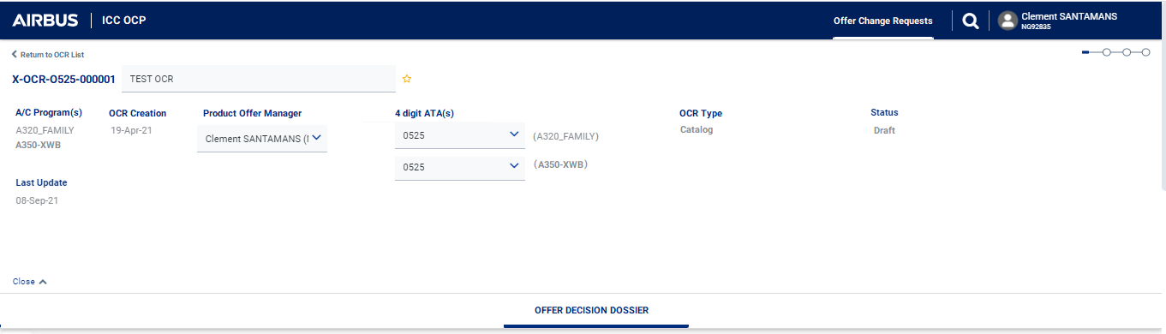
OCR header
PI21

Slide 25
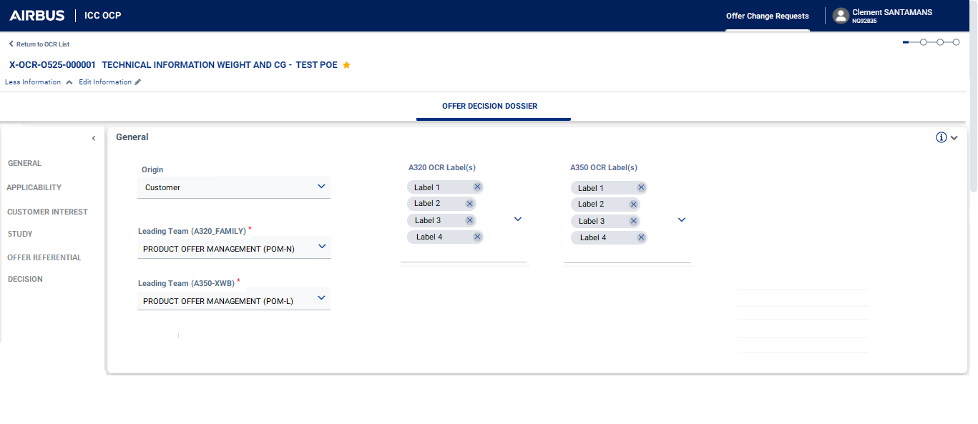
Offer Dossier : GENERAL
PI22

Slide 26
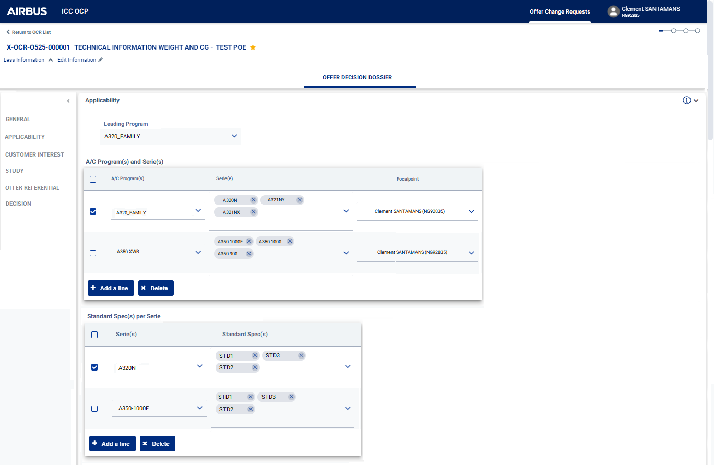
PI22

Slide 27
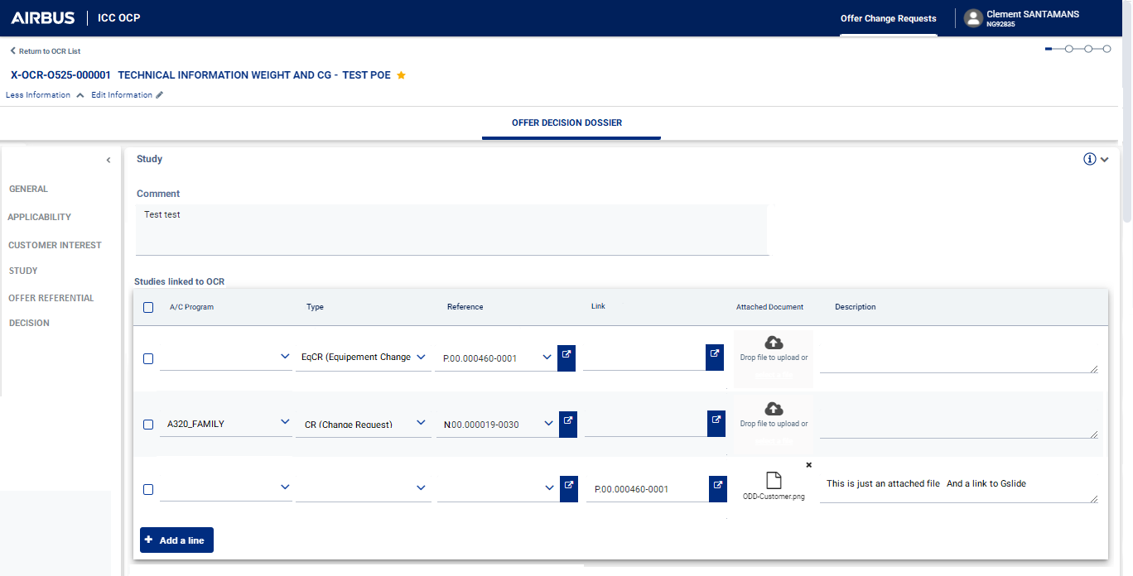
PI22

Slide 28
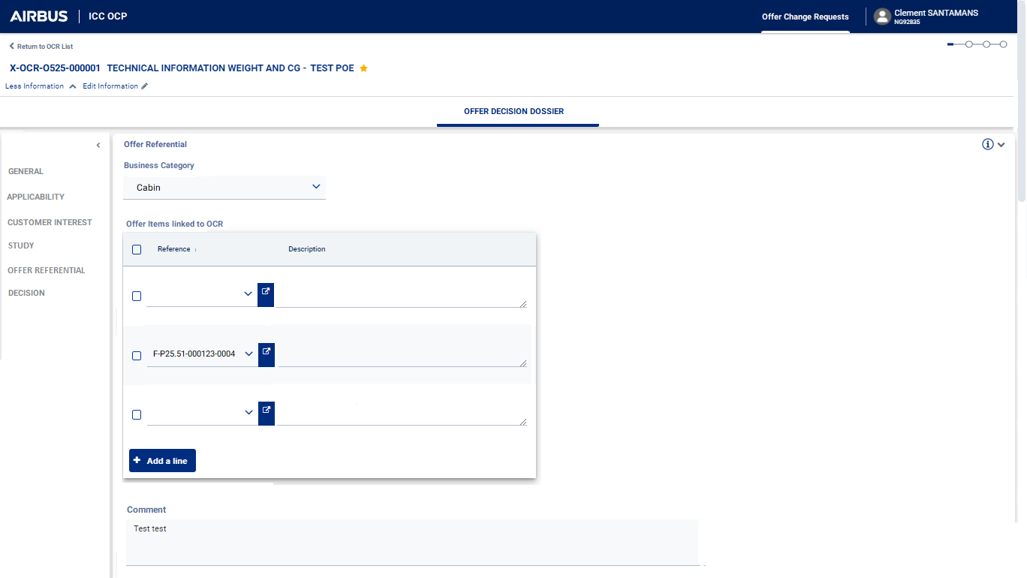
PI22
PI23

Slide 29
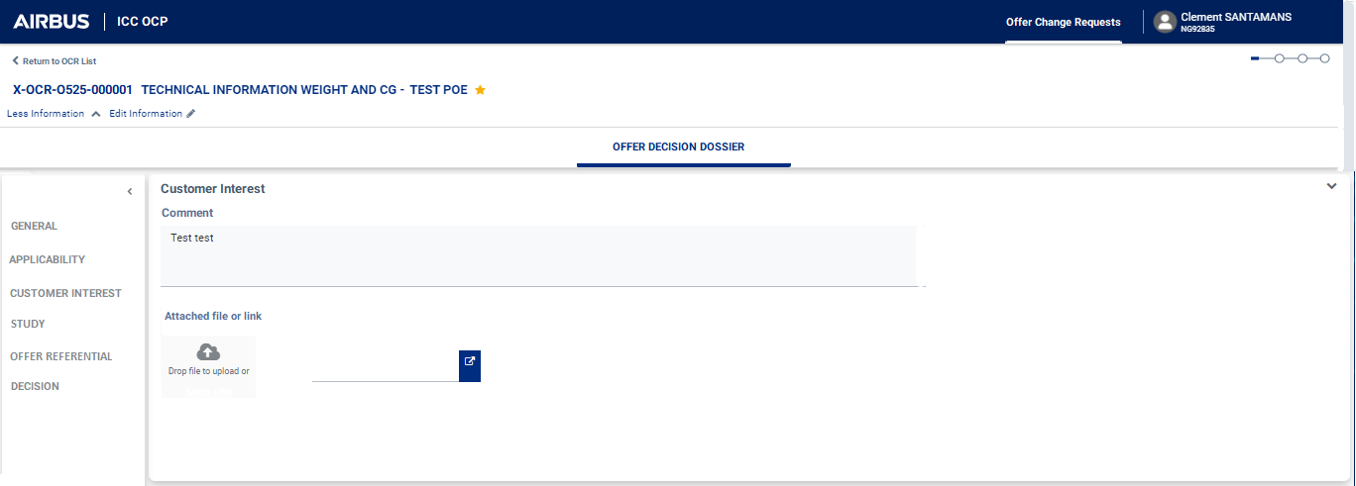
Offer Dossier : CUSTOMER info
PI23

Slide 30
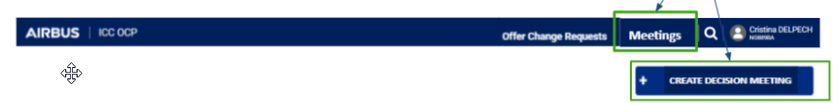
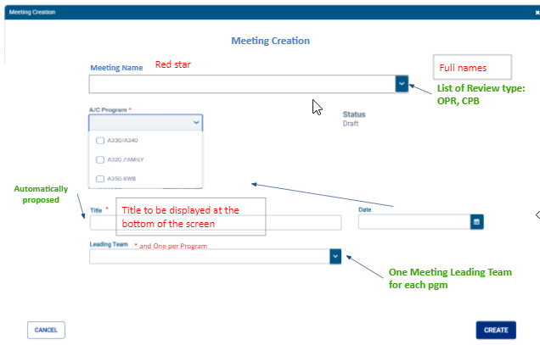
Create an Offer meeting: CPB or OPR/Alignment Meeting
PI23
DRAFT

Slide 31
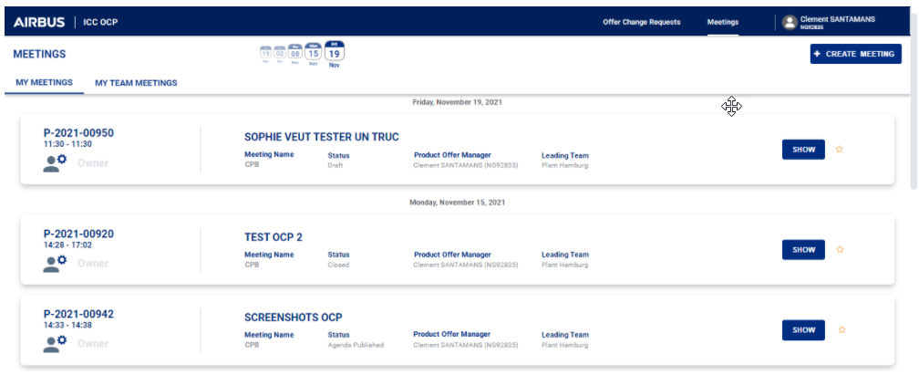
My Meeting List
PI23

Slide 32
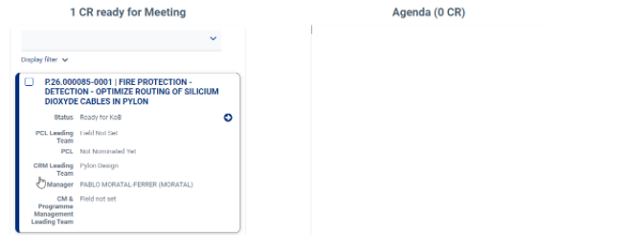
Manage Meeting Agenda (E-209940)
PI24
-> Publish Agenda

Slide 33
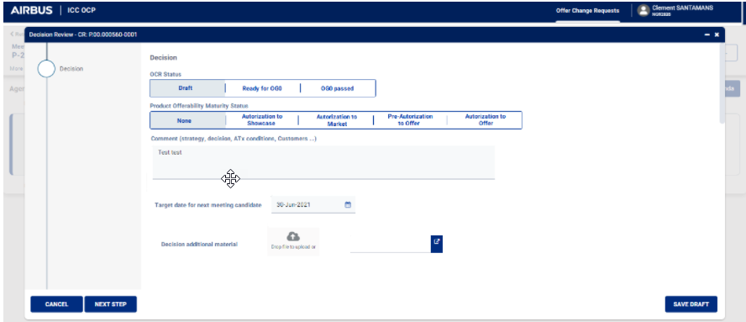
Run a meeting & MoM (E-209943)
PI24
Start meeting -> Add decision on each topics -> Stop meeting -> Validate MoM
How to add a decision:
Decision for OCR Catalog type:

Slide 34
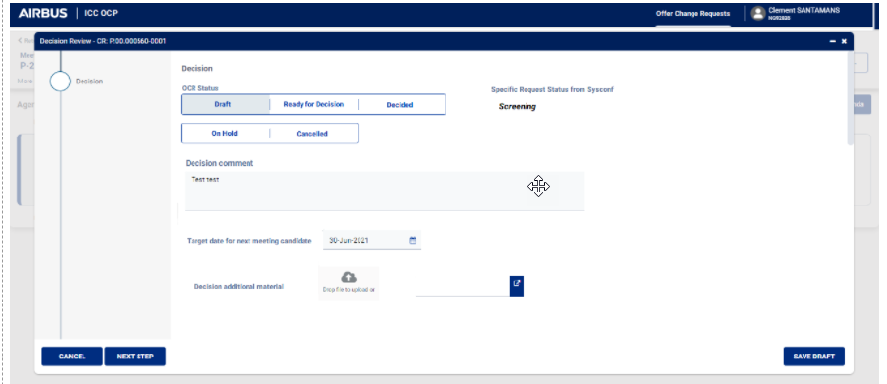
Run a meeting & MoM (E-209943)
PI24
Decision for OCR SR type:

Slide 35
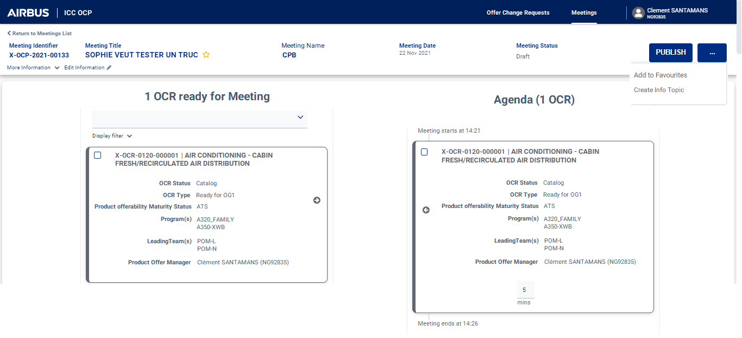
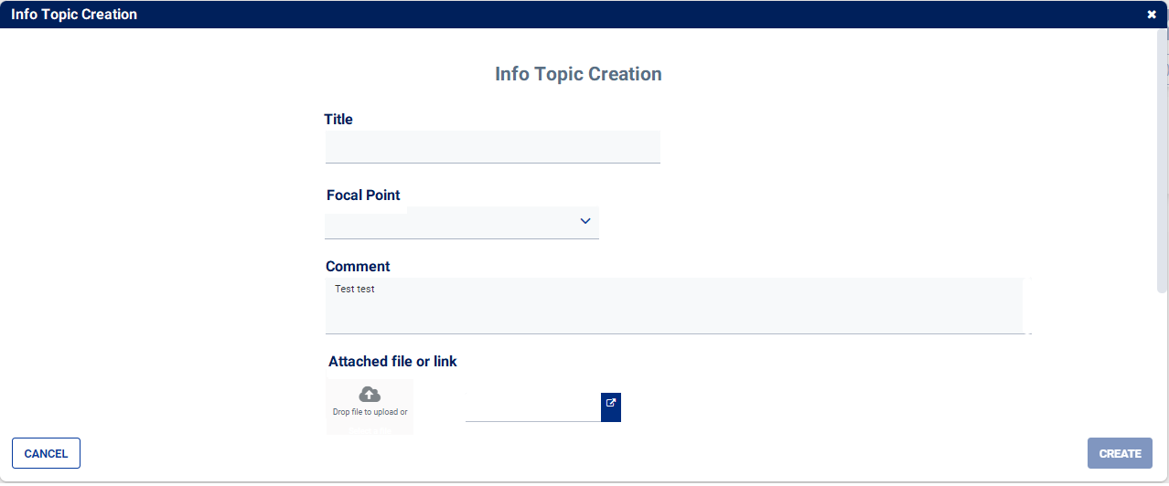
Create info topic in Meeting Agenda (E-209941)
PI24
DRAFT

Slide 36
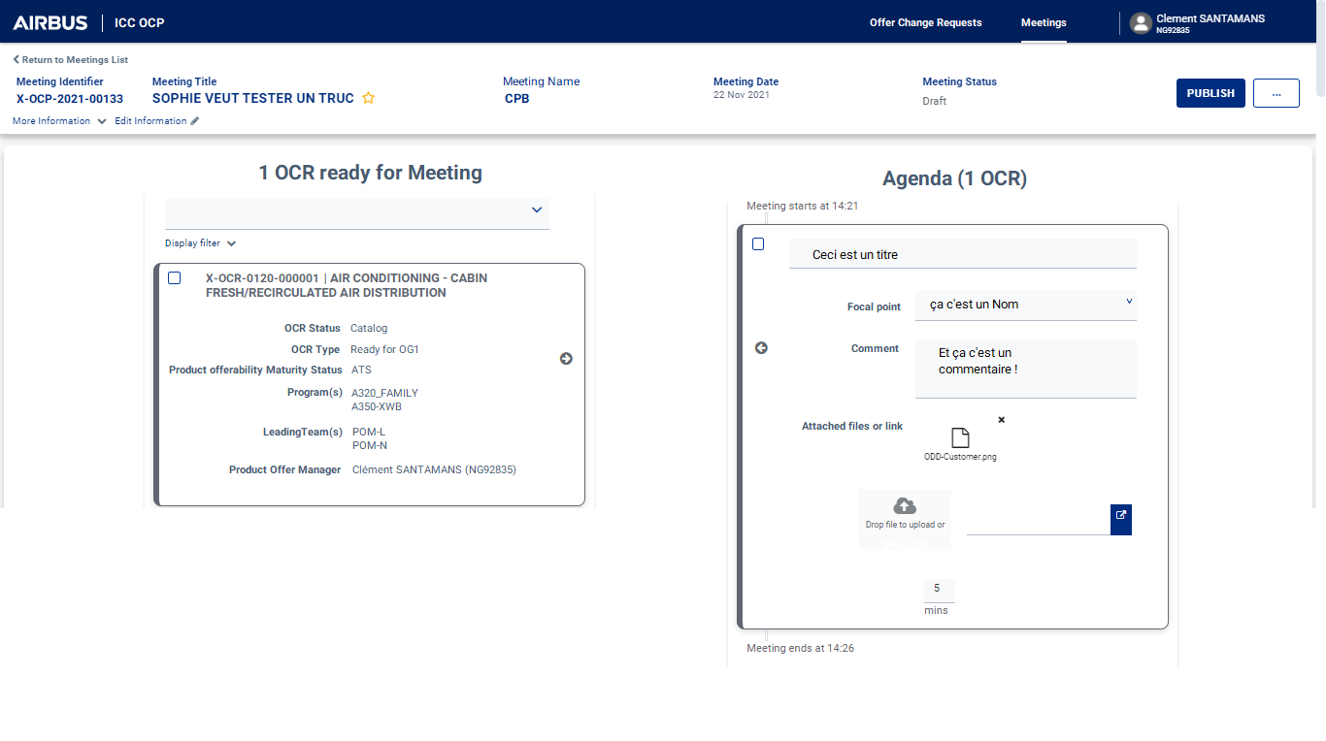
Create info topic in Meeting Agenda (E-209941)
PI24
Manage Info topic in the Agenda

Slide 37
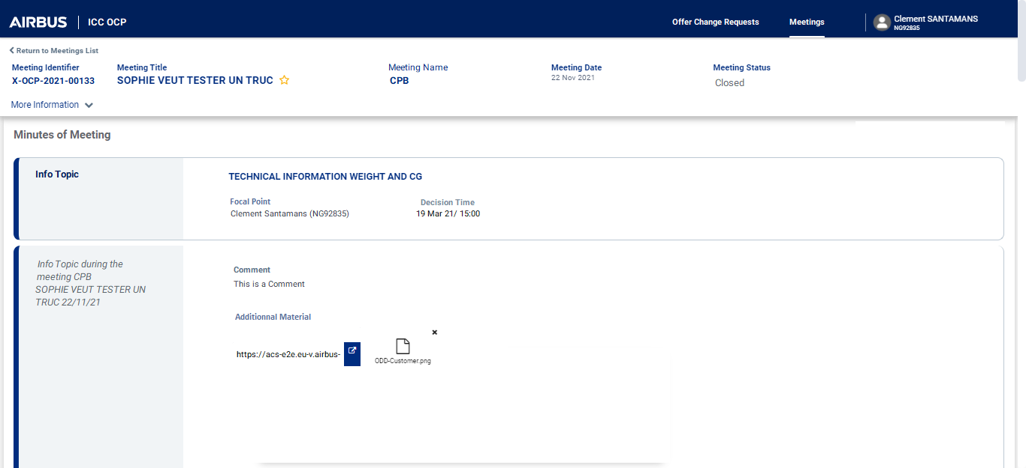
Create info topic in Meeting Agenda (E-209941)
PI24
Display Info Topic in the MoM

Slide 38
PI25 features candidates, in priority order:
Remain To Do [Lean PLM 2.1] OCP - OCR out of meeting DECISION for Catalog & SR (E-207183)
[Lean PLM 2.1] [OCP] E-235635 - Manage Meeting Participants
[Lean PLM 2.1] [OCP] E-235638 - Export Agenda
[Lean PLM 2.1] OCP - Offer MoM export (E-223514)
[Lean PLM 2.1] OCP - Create Offer CR CONTEXT (E-209712) & RTD
[Lean PLM2.1] OCP - Versioning management (E-209944)
ICC-OCP Data exposure
Backlog for PI26:
[Lean PLM2.5] OCP - E-228345 - Notifications management
[Lean PLM 2.5] OCP Feature E-235349 - POM external role management
Global search
Filters functionality for ICC-OCP MVP
ICC-OCP Data exposure

Slide 39
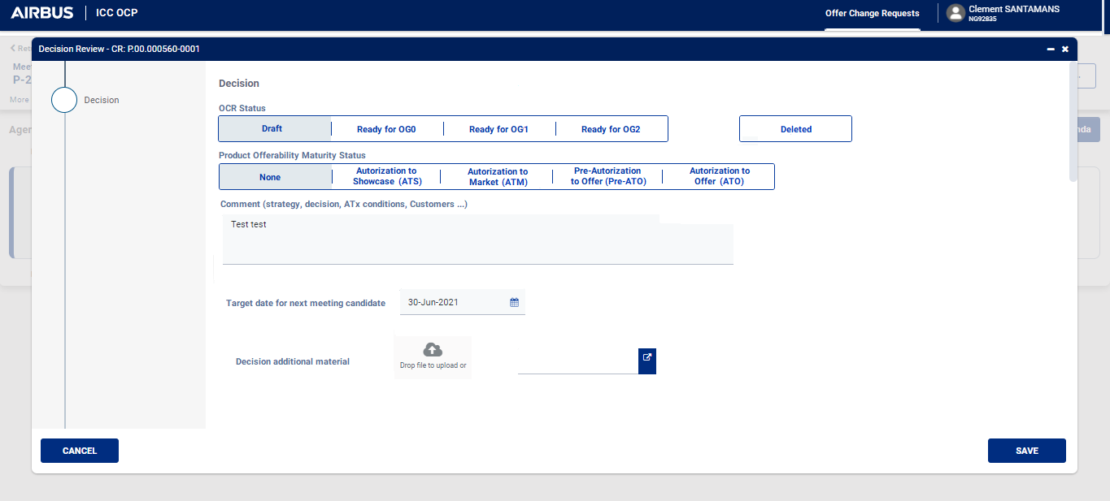
OCR out of meeting DECISION for Catalog & SR (E-207183)
Log the decision

Slide 40
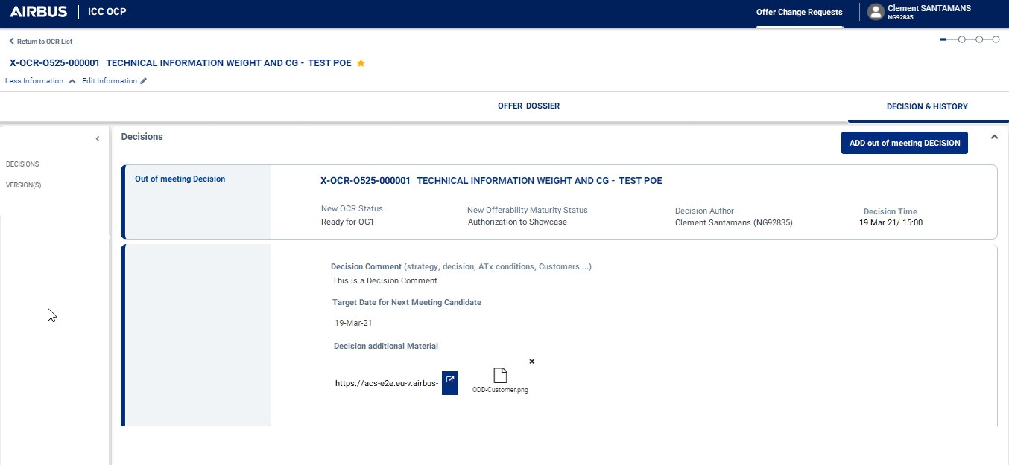
OCR out of meeting DECISION for Catalog & SR (E-207183)
Visualize the decision (MoM)

Slide 41
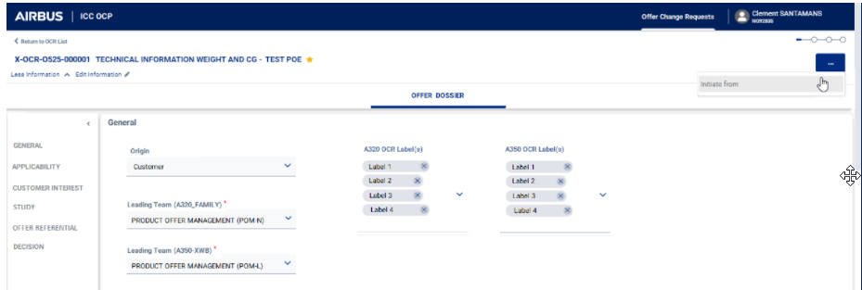
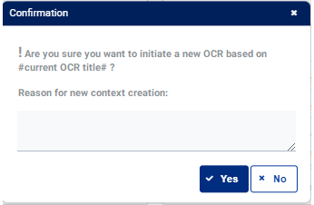
Create new OCR CONTEXT (E-209712)
OCR duplication to enable new context management

Slide 42
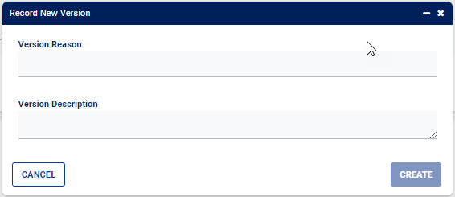
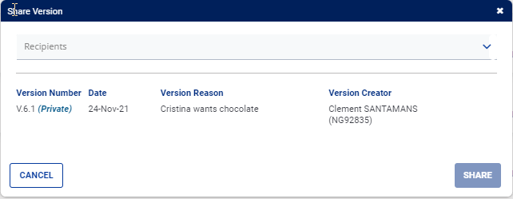
Versioning
Automatic and manual versioning
DRAFT

Slide 43
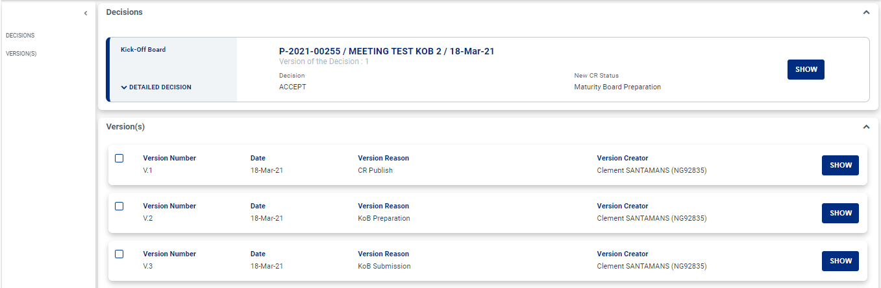
Versioning

Slide 44
BI25 planned topics (already started):
Topics related to features/development:
[Lean PLM 2.5] OCP Feature E-235349 - POM external role management : need for alignment
Global search
[Lean PLM2.5] OCP - E-228345 - Notifications management
Filters functionality for ICC-OCP MVP
ICC-OCP Data exposure
Info topics management improvement (costing of possible solutions)
Other activities:
ICC-OCP tests by Business -> next session planned May 26th
Deployment plan definition
ICC-OCP Assistance site definition
ICC-OCP Business Operation Support set-up
A350 POT data migration (A350 only)

Slide 45
Questions
&
Answers

Slide 46

EPIC2.1 – OCP
Updated on :19/04/22
S Calvet
6 Minutes
Progress/Achievement
ICC-OCP Minimal Valuable Product status: approx. 60% developed (approx. 12 developed features over 22 planned features) Refer to Master Roadmap milestones: Go Live ‘test’ in Panama done Preliminary Go Live MVP at Red Lotus : planned Minimum Valuable Product Go Live for EIS at Sangria: planned
Highlights
ICC-OCP MVP date EIS at risk: @CPAO-ART: Ensure Minimum Valuable Product scope is developed for Sangria release
Issues/Risks (may require support)
ICC-OCP MVP EIS date at risk: approx 10 ‘big’ features to onboard => need for higher dev team capacity, risk for Entry Into Service delay or functions delay (e.g. notifications, search) ICC-OCP Intermediate Valuable Solution planning at risk: integrated processes need to be defined & validated (UC#10/11, UC#01), need to set priorities (UC#01 SR recommanded)
Next to Come
ICC-OCP Minimum Valuable Product remaining features: out of meeting Decisions, Meeting participants, Agenda & MoM export, Initiate from CR, OCR Versioning, Notifications, POM external role, Data exposure, Global Search EIS preparation: ICC-OCP assistance site & trainings, deployment plans Business Acceptance Tests Business Operation Support set up Improvement assessment: info topics management

Slide 47
[Lean PLM EPIC2.1] - BI 23 Review - OCP in ACS
Wrap up
Topic mature to be proceeded
Topic requiring some adaptation to be proceeded
Topic not mature to be proceeded
Lean PLM EPIC2.1 Offer Change Process project, Offer Change Process Minimum Valuable Product scope (OCP MVP)
Project roadmap and status
Presentation of already performed development for OCP MVP (in PI21, PI22 and PI23): ICC-OCP
Presentation of candidate features for PI24 (starting in March) and BI24 planned activities
Concern / open points / Blocking points description | Addressed by | Actions
A. Should the Offer be integrated in the CM plan? How the offer is managed after delivery (E/T after delivery)? | Cécile LERMUZEAUX VANHOVE | From a process perspective the Offer should be part of the CM plan. This is not formalized yet ( MéMo to support). The management after delivery is not part of the MP.AC process.
B. If a flag/warning (risk) is raised on a EPAC/TDU, how do we manage the digital continuity in operations to remove this risk? | Cécile LERMUZEAUX VANHOVE | This is managed under Aircraft Change Process (not at DOP level) EPIC2.1: check that this is covered in identified use cases.
C. When will the creation of SR be implemented in ACS? | Patrick POINDRELLE | SR management is part of the Contractual Management Epic 1. Solid Synchronisation planning needed in order to secure the interface activities
D. What is the level of confidence on MVP (Step 1) and the migration at the end of the year? | Rémi DUPONT | Good level of confidence for MVP and for the migration we can anticipate by launching the study earlier (in July) by IZCD/BLV/System Architect
E. Clarify the Offer Reference to be taken into account in OCP concerning the EPAC/TDU or Offer items for MVP | Patrick POINDRELLE | Following Decision Dossier outcomes
F. Identify the different EPAC/TDU categories and define how they will be managed (esp. “TDU of change” e.g. change of seat P/N) | Patrick POINDRELLE | To be investigated together EPIC 2.1 and 2.2

Slide 48
[Lean PLM EPIC2.1] - BI 24 Review - OCP in ACS
Wrap up
Topic mature to be proceeded
Topic requiring some adaptation to be proceeded
Topic not mature to be proceeded
Lean PLM EPIC2.1 Offer Change Process project, Offer Change Process Minimum Valuable Product scope (OCP MVP)
Project roadmap and status
Presentation of already performed development for OCP MVP (in PI21,PI22, PI23 and PI24): ICC-OCP
Presentation of candidate features for PI25 (starting in April) and BI24 planned activities
Concern / open points / Blocking points description | Addressed by | Actions
A.When the temporary Removal/Removal of an Option from the catalogue will be managed (e.g.obsolescence of an item, du to specific risk, supplier risk…)? | Malika FARHI | This topic is taken into account in the OCP roadmap (step 3, 2024)
A. How to manage the obsolescence of an item if OG2 passed before 2024? | Malika FARHI | Managed by different Selling Policy? Need to analyse the real need in short terme
A. Will there be a dedicated role created for OCP usage? | Martin ROMPA | Yes, the role of POM is used in OCP
A. Is this role of the POM extended/reused on other perimeters when we have interdependencies with other organisations? | Patrick POINDRELLE | We need to clarify the activities behind this role starting the next BI when we will start working on the MSCN management
B.Need to secure the attendance and the business for BAT as this will happened during the summer holidays. Need of training on BATs | Patrick POINDRELLE | Will be taken into account. Maybe performed during Sept/Oct?
C. Is there a dedicated team for the BATs and the DEMOs? | Romain VIGEON | OCP team is performing the BATs, Demos, Trainings for the moment
C. Linkage with E/T Sysconf is a key functionality for Business for data continuity.Is this in the scope of the MVP? | Patrick POINDRELLE | Topic taken into account during futur BIs
C. Is the OCR linked to E/T or Offer Items in the first step? | Rémy AUCLAIR | The target was defined to take into account the Offer items.
Are we managing the risk for descoping certains topics for MVPs? | Loïc ALBAC | There are logged and followed during the PRM. To be added in the next BI presentation

Slide 50
Offer Process needs
to-be ACP/Offer integration level assessment:
High
Medium
low
Offer Change PROCESS high level scope (MP.AC.02):
Manage ‘Answer Specific Request’ workflow: cf Use case #01
Manage Develop Offer Process: cf Use case #10, #11, #16
Manage Offer Life cycle (selling policy, selection conditions, or Offer item characteristic): Use Case #12, #16, #06
Manage Offer Product Structure (break-down)
Manage Change of Best Seller - pre-design - TBD (Use Case #13)
Manage Catalogue up-issue (Product Configuration) (Use Case #14)
Manage Standard impacts on custo Offer (Use Case #28)
Manage Standard Offer
Manage Standard Specification up-issue (Product Configuration) (Use Case #15)
Manage A/C standard Change with MSCN (Use Case #26)
Main Business needs: Offer Change creation/management/follow-up, Offer decisions management, Offer Boards/meeting managements, studies management/workflow, link to/trigger other Change objects and Offer items
Cross-pgme expressed needs:
Step 1 (MVP): manage cross-pgme board (e.g. A330/A350, and cross-pgme until ATM): one meeting with subjects from different pgm domains set in the agenda
Step 2: manage cross-pgme study (RFW, business case), manage cross-pgme Offer items/Catalogues

Slide 51
Organisation Breakdown Structure (OBS)
DRAFT
EPIC 2.1
Pablo MORATAL
EPIC 1
‘FCO dev’ team
MP.AC.02
MP.AC.03
MP.PM.03
Offer
Change
Eqpt Change
FCO
Solution Manager: NOEMIE BERNABEU
System Architect: AYMERIC ALIBER
Process
Sophie CALVET
IZCD
Elisabeth BOURGARGIES
IZCM
Stephane RICHARD
IZCY
Sophie ROCHER
BXMD
Product Offer
For Steering
(MP.AC) CPAO train - dev team
A350/A330
A320 Family
Alexandre PODDA - BLVO
Marie ROUJA – BSVO
Laurence MONTEIL - BSMCC
Michael VAISSIERE/ Amelie PEREA (RTE) , DPCP
Béatrice GIRMA-VIDAL (PM for Offer) , IZCD
Celine COUTURE/Sebastien VOEGELE (PM for ACP) , IZCM
Product Offer
Core team
System Architect:DPCP
Clément SANTAMANS, Elodie CANTON
A350/A330
A320 Family
Business focal: Rémi DUPONT,
Malika FARHI, Gerd ROHLFS / Annabelle STREKER
Lutz SHAPKE
Christine TARDY
Patrick POINDRELLE
Loic ALBAC
Ludovic JAILLET
Cecile BOUSQUIE
CPAO dev teams: DP
Jocker team (PI21)
OSS117 (PI22, 23, 24)
Bugbusters (PI23, 24)
Page ‹#›
Scrum Master: DPCP

Slide 52
Budget Status
Funding Source for project and dev (IZC & DP) | 2021 | 2022 | 2023 | 2024
BLVO M&T (MSOD) for POT obso | - | 45k€ for IZCD (Project) 175 (incl 70 for migration) for DPC
BSVO/BSMCC | - | -
Lean PLM EPIC2.1 | 150k€ | 200k€ for DPC | shared within EPIC 2.1 | shared within EPIC 2.1
Consumption for developements | 2021 | 2022 | 2023 | 2024
DP dev team | approx 80 Story Points | appox 16 SP PI23
ICC-MVP costing (at G5):

Slide 53
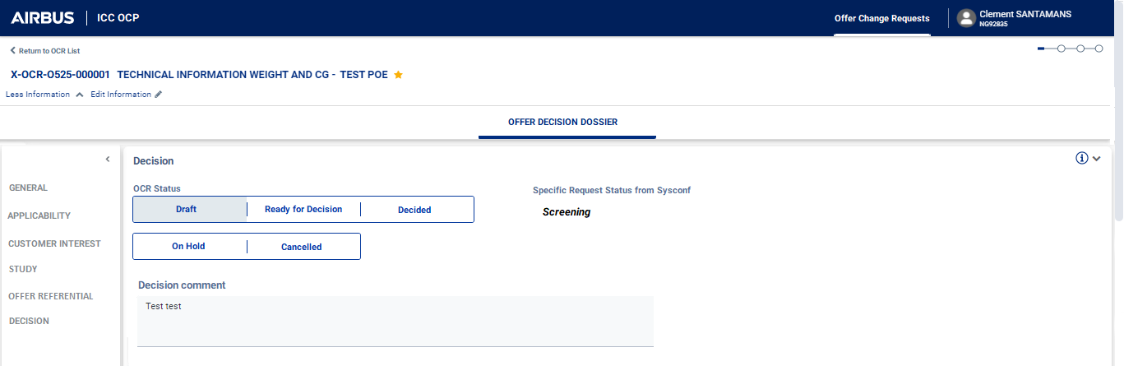
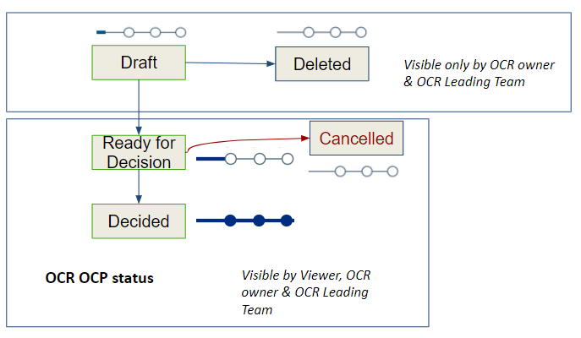
DRAFT

Slide 54
